Slide 1
Heavy Metals
Gillian Beauchamp, MD

Slide 2
Mystery Case 1
7 year old boy
6 months of Impulsivity, difficulty concentrating
Takes iron for anemia, diagnosed by his pediatrician 3 months ago
Lives with mother in grandparents’ home
Home business: automobile radiator repair shop
Picky eater: complains of abdominal pain when he ‘doesn’t want to go to school’
No compulsive eating of non-food items
Family history: grandfather with chronic abdominal pain

Slide 3
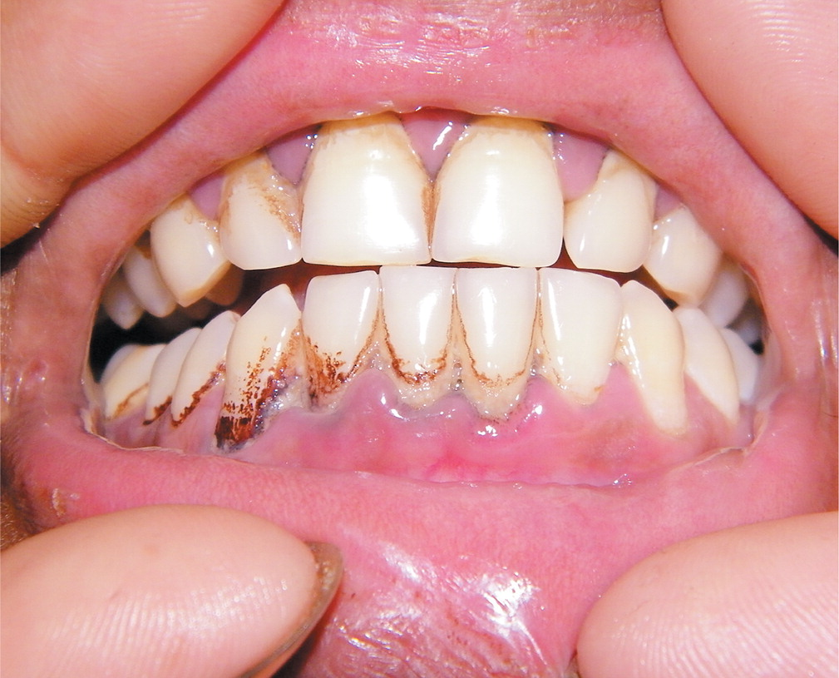
Exam
Thin, small child
Active in the room – short attention span
10% for height and weight

Slide 4
Quiz
What is the differential diagnosis for this patient?

Slide 5
Differential Diagnosis
Microcytic Anemia
Decreased Concentration
Iron deficiency
Hemoglobinopathy
Lead poisoning
Attention deficit
Hyperactivity
Depression
Anxiety, social phobia, OCD
Absence seizures
CNS infection
Notes:
Differential diagnosis for a 7 year old male with decreased concentration, low weight and height and decreased concentrations anemia.

Slide 6
What tests would you like to order?

Slide 7
What tests would you like to order?
CBC with peripheral smear
Blood lead concentration
BUN and Cr
Urinalysis

Slide 8
Summary of Mystery Case 1
7 year old boy
Decreased appetite, intermittent abdominal pain + low weight
Decreased concentration
‘Iron deficiency anemia’
Lives in grandparents’ home
Home business: vehicle radiator repair

Slide 9
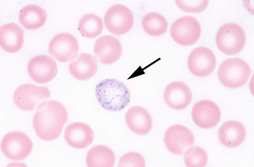
Work Up
CBC: H/H 9.5/ 27.5 (Normochromic, microcytic)
Peripheral smear: basophilic stippling
Creatinine: 1.0 mg/dl (0.2 – 0.8 mg/dl)
UA: normal
Blood lead concentration: 120 mcg/dl
www.medicallabs.net

Slide 10

Mystery Case 2: The Same Toxin!
Notes:
Gout, HTN, vague symptoms
Painting the Rama 9 Bridge - October 6, 2007
Recently the previously non-description grey Rama 9 Bridge has been painted royal yellow to match the Mega Bridge – a bridge workers complains of 3 months of worsening vague abdominal pain, fatigue and gout.

Slide 11

Fatigue, Gout & Abdominal Pain
Webmd.com
Notes:
A 42 year old bridge worker (painter) complains of 3 months of worsening vague abdominal pain, fatigue and gout since starting the re-painting of Rama IX.

Slide 12
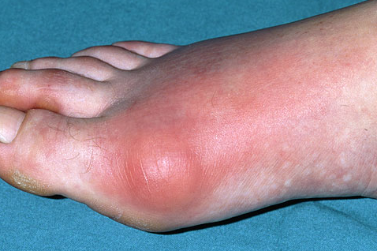
Exam
History: tobacco use
BP: 156/88
Benign abdominal exam
Webmd.com

Slide 13
Quiz: What toxic exposure do you suspect?

Slide 14
What toxic exposure do you suspect?
Lead poisoning

Slide 15
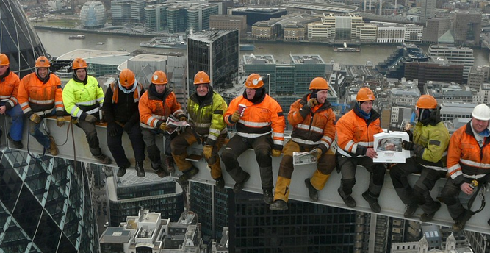
Is decontamination needed to protect emergency department staff?
Exposure likely chronic (over 3 months)
Scraping, sanding or sandblasting
Use of torches or saws
Lead dust
Inhalational exposure
Ingestion
www.dailymail.co.uk
Notes:
anything which is made of iron/steel and comes in contact with the elements will develop a rust problem. Bridges, water towers, outdoor stadiums, and some electrical towers fall into this category. In order to have the iron/steel last it must have a protective coating placed upon it to preserve it. Paints with lead additives are the best way to protect the metals. Year after year the bridges of this country are coated over and over with lead paint.
Lead paint on bridges and structural steel and concrete creates hazards when cut with torches and saws. Lead melts at 621ºF and boils at 3164ºF, or well below the temperature at the tip of a cutting torch. The lead is vaporized when exposed to the high temperature of the torch and this vapor is then available to be breathed in. Dust is generated by cutting with cut-off saws, scraping or sanding, or sandblasting lead coated materials. This dust is also hazardous because it may be in the air (to be breathed in), or as larger dust particles. These particles settle on surfaces and hands, and can then be ingested when workers eat lunch or smoke.
Paint containing lead is used to protect the infrastructure from rusting out. Here the paint is applied to the steel member before being placed and acts as a protective barrier against air pollutants, acid rains, and anything else that may attack the metal and start its decay. Lead handles this job in a very effective way because of its elasticity, meaning it has the ability to move with the steel either in expansion or contraction.

Slide 16
What Tests Do You Want to Order?
Notes:
EP: erythrocyte protoporphyrin – accumulates in blood due to erythrocyte dysfunction (can be due to iron deficiency anemia, hemolytic anemia or lead toxicity)
ZPP: zinc protoporphyrin (another way to assay EP)
Recent data indicate that the EP/ZPP assay at lower BLLs is not sufficiently sensitivity, and therefore is not as useful a screening test for lead exposure as previously thought. EP/ZPP assays continue to be used at times as a complement to venous BLL testing and are required by OSHA for some workplace testing.
Normal values of ZPP are usually below 35 µg/dL.
EP/ZPP reach steady state at 120 days after entire population of circulating erythrocytes have been turned over – so lags behind blood lead concentrations and is only an indirect measure of long-term lead exposure
EP is also elevated in
iron deficiency anemia
jaundice
sickle cell
other hemolytic anemias
In erythropoietic protoporphyria, an extremely rare disease, EP is markedly elevated (usually above 300 µg/dL).

Slide 17
What Tests Do You Want to Order?
CBC with peripheral smear
Blood lead concentration
BUN and Cr
Urinalysis
Notes:
EP: erythrocyte protoporphyrin – accumulates in blood due to erythrocyte dysfunction (can be due to iron deficiency anemia, hemolytic anemia or lead toxicity)
ZPP: zinc protoporphyrin (another way to assay EP)
Recent data indicate that the EP/ZPP assay at lower BLLs is not sufficiently sensitivity, and therefore is not as useful a screening test for lead exposure as previously thought. EP/ZPP assays continue to be used at times as a complement to venous BLL testing and are required by OSHA for some workplace testing.
Normal values of ZPP are usually below 35 µg/dL.
EP/ZPP reach steady state at 120 days after entire population of circulating erythrocytes have been turned over – so lags behind blood lead concentrations and is only an indirect measure of long-term lead exposure
EP is also elevated in
iron deficiency anemia
jaundice
sickle cell
other hemolytic anemias
In erythropoietic protoporphyria, an extremely rare disease, EP is markedly elevated (usually above 300 µg/dL).

Slide 18
Test Results
Hemoglobin: 12 g/dl (14 – 18 g/dl)
Hematocrit: 38 % (41% – 53%)
Normochromic, normocytic
No basophilic stippling
Creatinine 1.3 mg/dl (0.6 – 1.2 mg/dl)
UA: trace proteinuria
Blood lead concentration: 70 mcg/dl

Slide 19
What Do These Patients Have in Common?
7 year old boy
42 year old bridge worker
Decreased appetite, intermittent abdominal pain + low weight
Decreased concentration
‘Iron deficiency anemia’
Lives in grandparents’ home
Home business: vehicle radiator repair
Fatigue
Gout
Abdominal pain
Hypertension
Mild creatinine elevation
Proteinuria
Mild anemia

Slide 20
Is Any Treatment Necessary?
7 year old boy
42 year old worker
Blood lead concentration: 120 mcg/dl
Chelation threshold: 45 mcg/dl
Tolerating PO
Blood lead concentration: 70 mcg/dl
Chelation threshold:
  70 mcg/dl asymptomatic
  45 mcg/dl symptomatic
Tolerating PO
Notes:
Succimer: for asymptomatic level over 45 ug/dl (70 ug/dl for adults) (lower level if symptomatic) - ie. Tolerating PO
-10 mg/kg PO TID X 5 days
-10 mg/kg PO BID X 14 d
-2 week hiatus with vitamins and iron, calcium
-Repeat 19 day cycle until Pb M 35-44 ug/dl - may require 3-5 cycles; some treat to level of 20 ug/dl - may gauge based on how patient is tolerating succimer

Slide 21
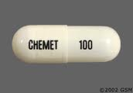
DMSA
2,3-dimercaptosuccinic acid
Succimer
10 mg/kg PO TID X 5 days
10 mg/kg PO BID X 14 d
2 week hiatus with vitamins and iron, calcium
Repeat 19 day cycle until lead concentration 35-44 mcg/dl
May require 3-5 cycles
Some treat to level of 20 mcg/dl
Notes:
Succimer: for asymptomatic level over 45 ug/dl (70 ug/dl for adults) (lower level if symptomatic) - ie. Tolerating PO
-10 mg/kg PO TID X 5 days
-10 mg/kg PO BID X 14 d
-2 week hiatus with vitamins and iron, calcium
-Repeat 19 day cycle until Pb M 35-44 ug/dl - may require 3-5 cycles; some treat to level of 20 ug/dl - may gauge based on how patient is tolerating succimer
DMSA: 2,3-dimercaptosuccinic acid
-oral chelator
-Approved by FDA for lead poisoning in children with blood lead conc > 45 ug/dl
-also used to treat poisoning by arsenic, organic mercury, inorganic mercury
-Can open capsule and put in soft foods for children

Slide 22
BAL
Dimercaprol
British Anti-Lewisite
Severe toxicity - encephalopathy
Deep IM injection: 4mg/kg IM Q 4h for 2-7 days
After 2nd dose of BAL, start Calcium Disodium EDTA: 1-1.5g/m2/day IV infusion over 8-12 h daily for 5 days, then skip 2-4 days, and repeat course as needed - max 75 mg/kg/day
Peanut oil: allergy
Side effects:
  HTN, fever, rash, conjunctivitis, lacrimation, blepharospasm
As soon as tolerating PO: succimer
Notes:
Severe toxicity (encephalopathic):
-Deep IM injection of BAL: 4mg/kg IM Q 4h for 2-7 days (in peanut oil so can't use if peanut allergy) - side effects: inc BP, fever, rash, conjunctivitis, lacrimation, blepharospasm
-After 2nd dose of BAL IM, then start Calcium Disodium EDTA: 1-1.5g/m2/day IV infusion over 8-12 h daily for 5 days, then skip 2-4 days, and repeat course as needed - max 75 mg/kg/day
-BAL smells strongly of peanuts in the room
-As soon as tolerating PO, can switch to succimer

Slide 23
Lead Toxicity
Naturally occurring element
Inorganic lead: inhalation and ingestion
  Paint
  Food: lead containers
  Water: lead-soldered plumbing
  Medications: folk remedies
Organic lead: found in gasoline as tetraethyl lead – inhalation and dermal
  Auto exhaust: mostly soil contamination
Notes:
Automobile emissions have been a source of exposure to lead – now reduced in many countries, but lead from prior emmissions exists in soil, where children may play (near roads or freeways)
Lead content of paint: begun to be regulated in 1977 in US – pica (compulsive eating of non-food items); mouthing of lead paint chips or soil
Food: acidic foods can leach lead from containers; lead glazes in ceramics
Water: from leaded pipes, soldered plumbing
Folk remedies: Mexican colic treatments; Asian and Middle eastern cosmetics

Slide 24
Patients at Risk
Occupational
Hobbies
Plumbers
Miners
Auto repair
Smelting & refining
Bridge reconstruction & painting
Firing Range personnel
Pottery glazes
Target shooting
Soldering
Fishing sinkers
Stained-glass makers
Home remodeling
Notes:
-Bird shot
-Leaded glass
-Fishing sinkers
-Trinkets
-Ceramic pottery
-Pool cue chalk
-Curtain weights

Slide 25
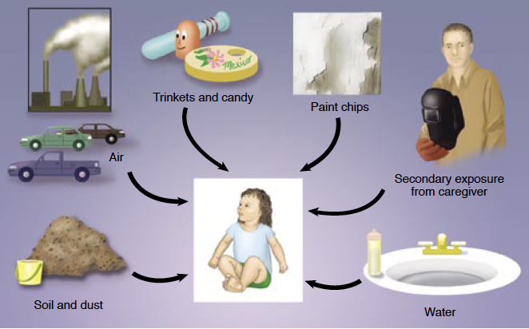

Slide 26
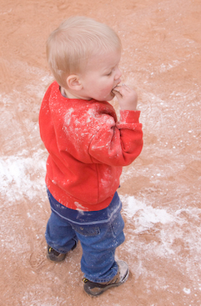
Acute Pediatric Lead Exposure
Lead Curtain weight
Fishing sinkers
Lead bird shot
Leaded glass & Crystal
Solder
Toy soldiers
Ceramic pottery
Pool cue chalk

Slide 27
Back to Our Patients
7 year old male
42 year old bridge worker
Old home
Automobile radiator repair
Paint chips – scraping, sandblasting
Meals on work site
Smoking
Notes:
-Lead pigments (typically lead carbonate) account for 50% by weight of many white house paints from the pre–World War II era.
-Since 1978, paint intended for interior or exterior residential surfaces, toys, or furniture in the United States may contain, by law, no more than 0.06% lead.
-~3 million tons of lead remain in 57 million U.S. homes built before 1980 and painted with lead-based paint.
-most lead paint exposure in childhood relates to the crumbling, peeling, flaking, or chalking of aging paint.

Slide 28
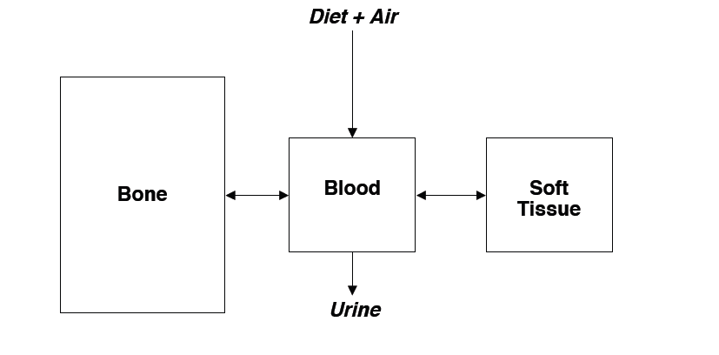
Pathophysiology of Lead Poisoning
Notes:
Once absorbed in the blood, lead is distributed to three compartments: blood, soft tissue (organs like kidney, bone marrow, brain and liver) and mineralizing tissue: bone and teeth (contains 95% of the body lead burden)
Under physiologic stress: childhood growth, pregnancy, chronic disease, lead is mobilized from stores and readily moves into blood.
Once in blood: is 99% associated with RBCs – so can be transported to tissues
Lead t1/2 in blood is 25 days; t1/2 tissues is 40 days; t1/2 in bone is 25 years

Slide 29
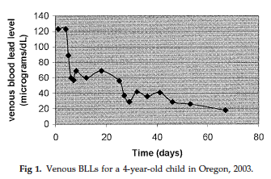
Quiz: Why Did the Child have Rebound Phenomenon?
Notes:
After a lead exposure, or with treatment, blood lead concentration can decrease, but total body burden may still be elevated, and inert lead can be mobilized. Lead toxicity can occur with large acute exposure, or multiple small dose exposures. Large total body burden – inc risk of adverse effects.

Slide 30
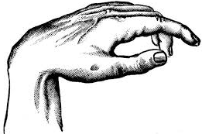
Lead: Neurologic Effects
Nervous system: most sensitive target for lead poisoning
Cognitive deficits and lower IQ scores
Delayed speech development & language processing
Decreased fine motor skills and reaction time
Decreased hearing acuity
Fatigue
Peripheral neuropathy: slowed nerve conduction velocity
  Anterior horn cell disease with peripheral dying back of neurons
  Wrist drop: late sign of lead poisoning
Notes:
Children under age 7 at highest risk due to incompletely developed blood brain barrier

Slide 31
Lead: Hematologic Effects
Interferes with hemoglobin synthesis via enzyme inhibition
Anemia
  Acute toxicity: hemolytic anemia
  Chronic toxicity:
    Decreased erythropoiesis
    Decreased RBC survival

Slide 32
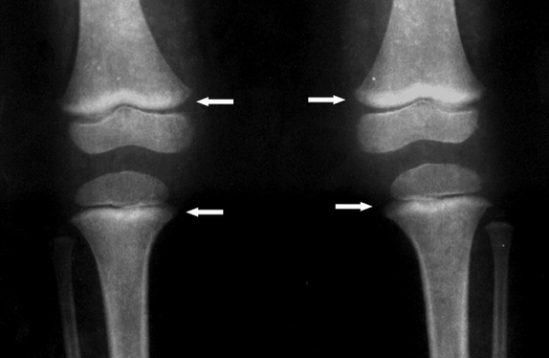
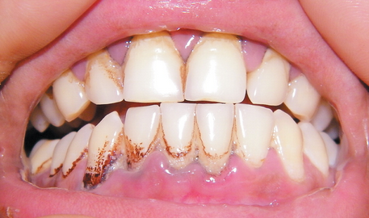
Lead: Endocrine Effects
Decreases blood concentrations of Vitamin D
Results in impaired calcium homeostasis
  Decreased stature
Impaired tooth and bone development
www.atsdr.cdc.gov
Notes:
Burton lines in teeth
Bone lead lines – can be seen 4-8 weeks after lead exposure

Slide 33
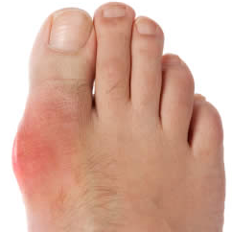
Lead: Renal Effects
Impairment of proximal tubular function = lead-induced chronic renal insufficiency
Aminoaciduria
Glycosuria
Hyperphosphaturia
HTN via renal mechanisms
Gout: hyperuricemia

Slide 34
Lead: Reproductive Effects
Prenatal exposure: low birth weight and prematurity
  Placenta provides no barrier: fetal lead = maternal lead
Possible association with reduced sperm counts and motility

Slide 35
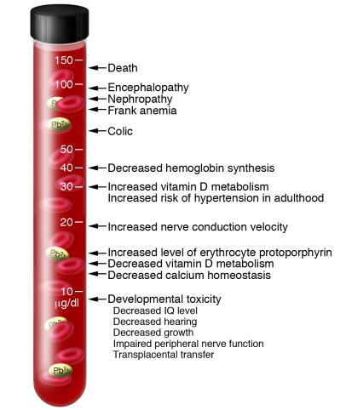

Slide 36
Standards & Regulations
OSHA Recommendations:
BLL > 19 ug/dL – monthly BLL
BLL < 40 ug/dL – Reinstate worker
BLL > 40 ug/dL – Medical exam
BLL > 50 ug/dL – remove from work area
Notes:
Physician reporting

Slide 37
Back to Mystery Case 1
Symptomatic: Decreased appetite + abdominal pain + low weight
Decreased concentration: CNS effects
Anemia: Hematologic Effects
  Basophilic stippling
  Microcytic
Renal effects: mildly elevated Cr
Risk factors: paint in home + lead soldered pipes + lead solder/dust in radiator repair shop

Slide 38
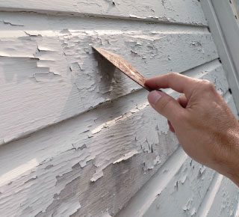
What is next?
Lead abatement and prevention of further exposure
  U.S. – homes built before 1978 are at risk
Assess other family members
Assess risk of iron and calcium deficiency
  X rays
Notes:
Grandfather with chronic abdominal pain; mother of child-bearing age
Assessment of hearing, speech and cognition
Current CDC action concentration is 5 mcg/dL

Slide 39
What is next?
Serial blood lead concentrations
  < 9 ug/dL – retest in one year
  10-15 ug/dL – retest in 3 months
  15-19 ug/dL – retest in 2 months
  20-44 ug/dL – Refer for clinical examination, environmental investigation and remediaion
  45-69 ug/dL – chelation
  > 70 ug/dL – hospitalize for immediate chelation and environmental control
Notes:
Grandfather with chronic abdominal pain; mother of child-bearing age
Assessment of hearing, speech and cognition
Current CDC action concentration is 5 mcg/dL

Slide 40
Back to Mystery Case 2
42 year old male bridge worker
Blood lead concentration: 70 mcg/dl
Chelation threshold:
  70 mcg/dl asymptomatic
  45 mcg/dl symptomatic
Tolerating PO

Slide 41
What is next?
Chelation and repeat blood lead concentrations until < 45 mcg/dL
Assessment of work place
Consideration of screening co-workers
Education: oral and inhalation exposure
  No food or smoking until decontaminated
  Mask

Slide 42
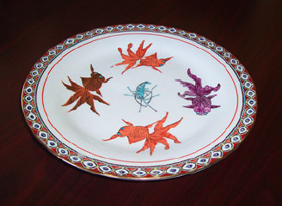
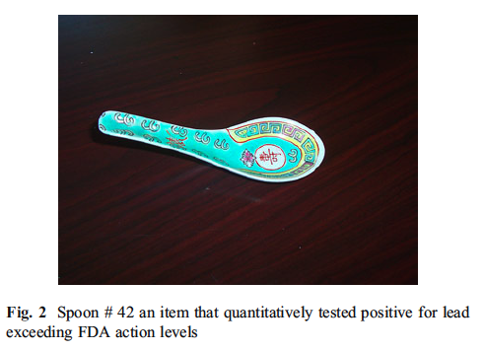
The Provider’s Responsibility
Has your child ever lived in or regularly visited a house, building, day care center, preschool, or home of a relative built before 1978?
Does your child live in or regularly visit a house or building built before 1978 with recent renovation or remodeling?
Does your child live with an adult whose job or hobby involves exposure to lead?
Did you or any other person ever give your child home remedies?
Do you keep food, or eat from ceramic dishes or pottery?
Do you live near an active lead smelter, battery recycling plant, or other industry likely to release lead?
Does your child play near roadways?

Slide 43
Neesanan et al. Preliminary study on assessment of lead exposure in Thai children aged between 3-7 years old who live in Umphang district, Tak Province. J Med Assoc Thai 2011.
213 patients
Mean age 54.54 +/- 12.41 month
Mean blood lead level is 7.71 +/- 4.62 microg/dl (range = 3-25 microg/dl).
1 of 4 of Thai children at Umphang district, Tak Province who lived near Burmese refugee camps aged between 3-7 years old have blood lead level higher than concerning level.
Thus, it is necessary to identify risk factors on lead exposure and policy of blood lead screening in some areas in Thailand.

Slide 44
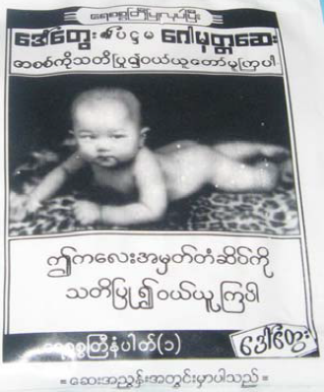
Daw Tway
Digestive aid used in Thailand
Analysis of Daw Tway samples showed them to contain as much as 970 parts per million (ppm) of lead and up to 7100 ppm of arsenic

Slide 45
Ambient Air Lead in Bangkok
WHO recommends annual average 0.5 ug/m³
Thailand standards:
  24 h average: 10 ug/m³
  Monthly average: 1.5 ug/m³
  Roadside:
    24 h average: 7.56 ug/m³ (1991)
    Monthly average: 5.09 ug/m³ (1990)
    Annual average: 2.16 ug/m³ (1989)
  General area:
    24 h average: 2.93 ug/m³ (1990)
    Monthly average: 1.69 ug/m³ (1990)
    Annual average: 0.43 ug/m³ (1989)
Notes:
Peak lead levels observed in Bangkok

Slide 46
High Blood Lead in Bangkok
1985-1992
Bangkok adult population: 16.2-19.6 mg/dL
Rural adult population: 8.6 mg/dL
Bangkok children: 11.2-18.8 mg/dL
Rural children: 4.4-8.2 mg/dL
Traffic police officers: 14.8-25.7 mg/dL
Bangkok bus drivers: 11.8-21.4 mg/dL
Notes:
WHO guideline: 98% of population should have lead levels below 20 mg/dL with a median below 10 mg/dL

Slide 47
Thailand phase-out of leaded gasoline
Before 1984: 0.84 g/L
1987: 0.45 g/L
1989: 0.4 g/L
1991: unleaded premium gas available
1992: 0.15 g/L
1994: phase out of regular leaded gasoline
1995: phase out of premium leaded gasoline

Slide 48
Goals of leaded gasoline phase-out
Decreased ambient lead concentrations
Reduce adult hypertension
Prevent decreased IQ in children
Annual cost savings: US $ 460 million

Slide 49
Quiz
What is the treatment for a 45 year old male with encephalopathy and a blood lead concentration of 120 mcg/dL?
What is the treatment for a 4 year old girl with 2% height, speech delay and a blood lead concentration of 70 mcg/dL?
What is the management for an 8 year old male who lives in a home built in 1953 and has a blood lead concentration of 30 mcg/dL?

Slide 50
Lead Treatment Summary
Acute Encephaloapthy
BAL , then CaNa2 EDTA
Start Succimer as soon as feasible.
SYMPTOMATIC:
PB > 45 mcg/dl
Succimer
ASYMPTOMATIC
PB > 70 mcg/dl
Succimer
PB < 45 mcg/dl
Abatement if possible
PB < 20 mcg/dl
Follow – up at regular intervals every 2-3 months

Slide 51
Quiz
What is the treatment for a 45 year old male with encephalopathy and a blood lead concentration of 120 mcg/dL?

Slide 52
Quiz
What is the treatment for a 45 year old male with encephalopathy and a blood lead concentration of 120 mcg/dL?
BAL and CaNaEDTA

Slide 53
Quiz
What is the treatment for a 4 year old girl with 2% height, speech delay, otherwise asymptomatic, and a blood lead concentration of 70 mcg/dL?

Slide 54
Quiz
What is the treatment for a 4 year old girl with 2% height, speech delay, otherwise asymptomatic, and a blood lead concentration of 70 mcg/dL?
Succimer

Slide 55
Quiz
What is the management for an 8 year old male who lives in a home built in 1953 and has a blood lead concentration of 30 mcg/dL?

Slide 56
Quiz
What is the management for an 8 year old male who lives in a home built in 1953 and has a blood lead concentration of 30 mcg/dL?
Consider remediation of environment
Repeat testing of blood lead concentration within 2 months

Slide 57
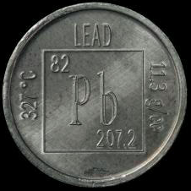
Questions?

